Slide 1
Employee Data Analysis using Excel
STUDENT NAME:G.NARMADHA
REGISTER NO:312203000
NM ID: 23D0E501864BBF5A672430A4B91420A6
DEPARTMENT:COMMERCE(B.COM)
COLLEGE:ASAN MEMORIAL COLLEGE OF ARTS AND SCIENCE

Slide 2
PROJECT TITLE
Employee Performance Analysis using Excel

Slide 3


AGENDA
Problem Statement
Project Overview
End Users
Our Solution and Proposition
Dataset Description
Modelling Approach
Results and Discussion
Conclusion
3/21/2024 Annual Review

Slide 4

PROBLEM STATEMENT
Employee performance evaluations will help you know if your employees are performing up to the standards and expectations. If you can conduct these evaluations regularly and properly, it will have a highly positive impact on your company.

Slide 5

PROJECT OVERVIEW
Performance Analysis is a specialised discipline that provides athletes and coaches with objective information that helps them understand performance. This process is underpinned by systematic observation, which provides valid, reliable and detailed information relating to performance.

Slide 6
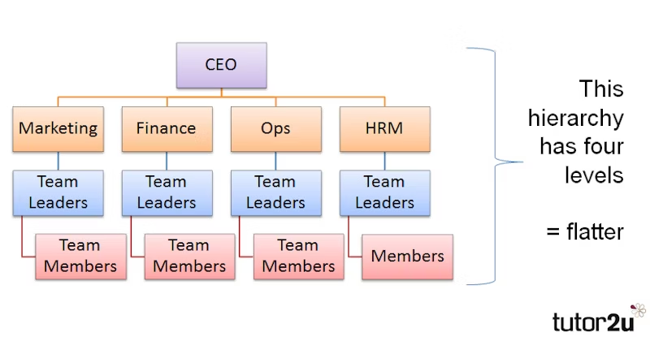

WHO ARE THE END USERS?

Slide 7

OUR SOLUTION AND ITS VALUE PROPOSITION
FILTERING
COLOURING
CONDITIONAL FORMATTING
PIVOT TABLE
SLICER

Slide 8
Dataset Description
EMPLOYEE DATASET COLLECT FROM IBM DASH BOARD
THERE ARE 26 FEATURES IN THE DATASET
ONLY 8 FEATURES WE COLLECT FROM THE DATA SET
1ST FEATURE WE COLLECT FROM THE DATA SET IS EMPLOYEE ID
2ND FEATURE IS FIRST NAME
3RD ONE IS TITLE
4TH ONE IS SUPERVISOR
5TH ONE EMPLOYEE STATUS
6TH ONE IS DEPARTMENT TYPE
NEXT ONE IS STATE
AND THE LAST ONE IS GENDER

Slide 9
MODELLING
DATA COLLECTION
1. DATA SET DOWNLOAD FROM EDUNET DATA BOARD
2. EMPLOYEE PERFORMANCE ANALYSIS USING EXCEL
FEATURES COLLECTING
THERE ARE 26 FEATURES IN THE DATA
EMPLOYEE ID, FIRST NAME, LAST NAME,DEPARTMENT TYPE,EMPLOYEE STATUS,EXIT DATE,ETC..
IN THIS 26 FEATURES WE COLLECT ONLY 8 FEATURES
EMPLOYEE ID,FIRST NAME,TITLE,SUPERVISOR,EMPLOYEE STATUS,DEPARTMENT,STATE AND GENDER.
9

Slide 10
DATA CLEANING
IF THE DATA CLEANING WE ALSO USE CONDITIONAL FORMATTING
IDENTIFING THE MISSING VALUES
USING CONDITIONAL FORMATTING AND HIGHLIGHTING BY COLOURS
REMOVE THOSE BLANK VALUES WITH USING FILTERS
SUMMARIZING (PIVOT TABLE)
COLLECT THE DATA FROM EXCEL SHEETS
SUMMARIZE THE VALUES USING PIVOT TABLE
A PARTICULAR DATA IS SET TO BE IN THE ROW,FILTER AND VALUE
AND WE USE SLICER TO SELECT THE FIELD TO USE FOR FILTERING LIKE SUPERVISOR

Slide 11
RESULTS
11

Slide 12
conclusion
IN CONCLUSION ,ANALYSING EMPLOYEE DATA USING EXCEL PROVIDES A ROBUST FRAME WORK
FOR GAINING VALUABLE INSIGHTS INTO WORK FORCE DINAMICS AND OPERATIONAL EFFICIENCY.
EXCELS DIVERSE ARRAY OF TOOLS AND FUNCTIONS,SUCH AS PIVOT TABLE ALLOWS FOR COMPREHENSIVE
DATA MANIPULATION AND VISUALIZATION

